Slide 1


SMS AND EMAIL SPAM DETECTION
TEAM NAME: AI08_TEAM_VISION AI
Team Members: -
1)Sneha Bhaskar
2)Sakshee Arude
3)Ishrath Fatima
Guided by:- Utkarsh Sharma

Slide 2
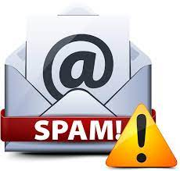
PROJECT TITLE SMS AND EMAIL SPAM DETECTION

Slide 3

AGENDA
Email Spam has become a major problem nowadays, with the Rapid growth of internet users, Email spam is also increasing. People are using them for illegal and unethical conduct, phishing, and fraud. Sending malicious links through spam emails can harm and seek into our system. Creating a fake profile and email account is much easy for the spammers, they pretend like genuine people in their spam emails, these spammers target those peoples who are not aware of these frauds. So, it is needed to Identify those spam mails which are fraud, this project will identify those spam by using techniques of machine learning, and we have selected the best algorithm for email spam detection having the best precision and accuracy.

Slide 4

PROBLEM STATEMENT
A competition between filtering methods and spammers is going on per day, as spammers began to use tricky methods to overcome the spam filters like using random sender addresses. So Using spam detection techniques to overcome email spam using spam filters.

Slide 5

PROJECT OVERVIEW
What is spam?- Spam email/SMS is unsolicited and unwanted junk email/SMS.
We have created a website that detects spam SMS/emails.
We have used machine learning algorithms to train our model.
HTML, CSS, and python flask are used to create a website.
We aim to provide a spam filter that protects the end user from unsolicited, unwanted, malicious links, spoofing, and money scam.
Thus, the spam filters will increase the efficiency and accuracy of spam detection.

Slide 6
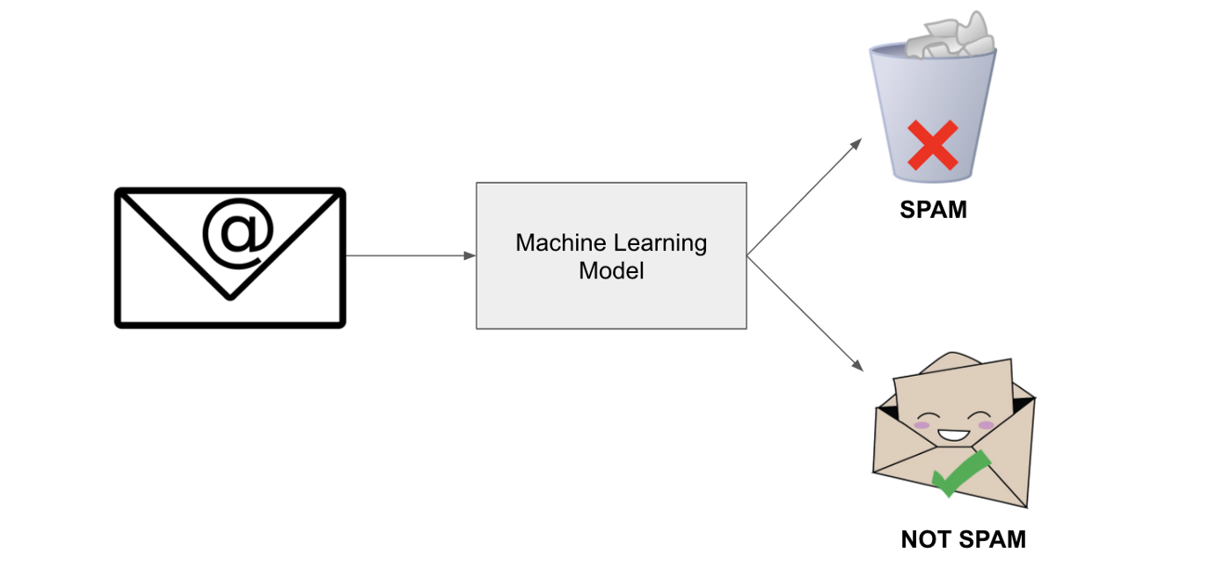
Spam Detection Using A Machine Learning Model

Slide 7
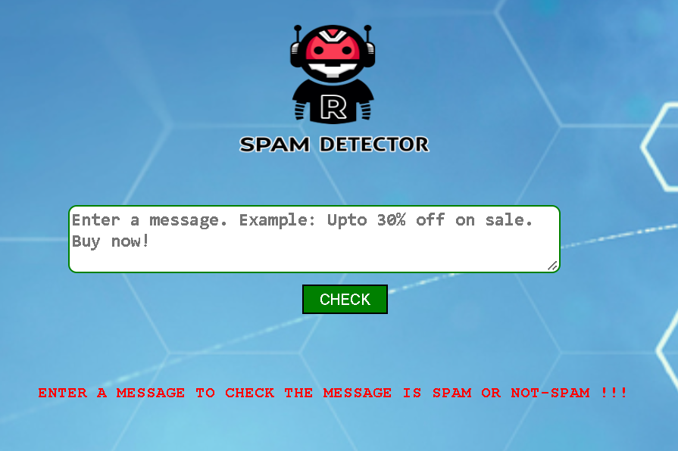
Spam detector website
Machine Learning Algorithms/Libraries
scikit-learn
flask
numpy
pandas
scipy
sklearn
joblib
Frontend
HTML
CSS

Slide 8
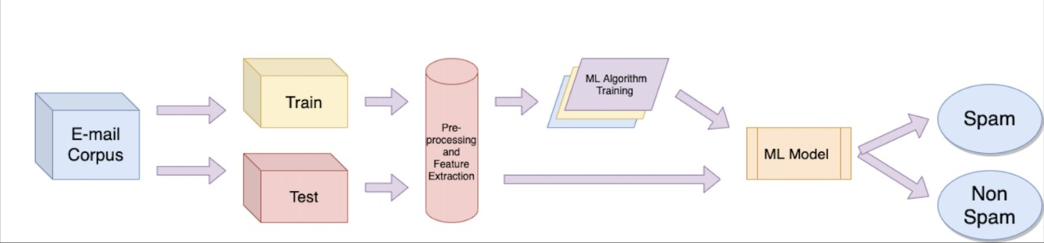
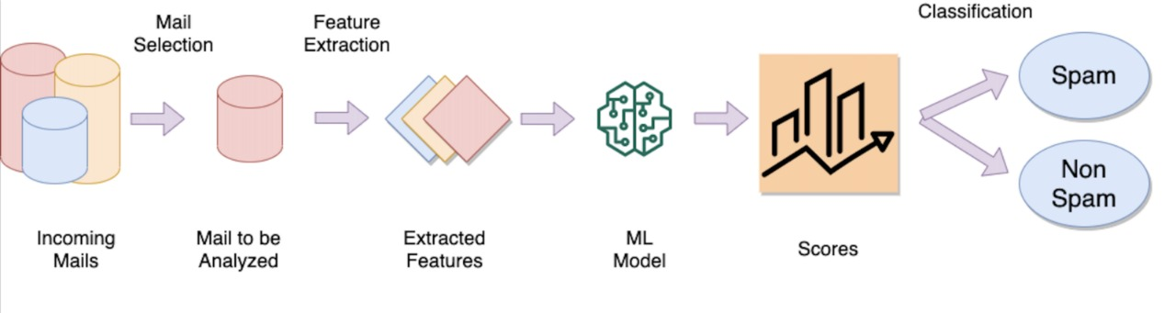
MODELLING
Training Testing Phase
New email classification

Slide 9


WHO ARE THE END USERS?
1. It’s for everyone who is using email service.
2. There are nearly 4.26 billion email users worldwide.
3. It is useful in different organizations, official, industrial, and business work for safe communication.

Slide 10
YOUR SOLUTION AND ITS VALUE PROPOSITION
1. Never give out or post your email address publically:-
You should remember that everyone can easily access the Internet. That means, spammers are also lurking on the Internet and are constantly seeking available email addresses to which they will send spam emails. Posting your email address publicly allows others to send spam emails to you, or worse, hack your account if you are using a weak password.
2. Think before you click there:-
Might be instances where your email service providers’ automated email filter mistakenly mark legitimate emails as spam email due to their content (e.g. the email contains a hyperlink). However, in most cases, emails marked as “SPAM” or redirected to the spam folder of your mailbox are sent by spammers.

Slide 11
YOUR SOLUTION AND ITS VALUE PROPOSITION
3. Do not reply to spam messages:-
Almost all spam messages are malicious emails sent by unknown sources. These sources could be hackers who aim to hack into the computers of their victims.
4. Download spam filtering tools and anti-virus software:-
Might be instances where your email service providers’ automated email filter mistakenly marks legitimate emails as spam emails due to their content (e.g. the email contains a hyperlink). However, in most cases, emails marked as “SPAM” or redirected to the spam folder of your mailbox are sent by spammers.
5. Avoid using your personal or business email address:-
Do not use your personal or business email address when registering in any online contest or service such as applications, deal updates, etc. Many spammers watch these groups or email lists to harvest new email addresses.

Slide 12
RESULTS
The primary goal of the proposed approach is to identify the SMS spam messages with high detection accuracy using the model Naïve Bayes classification using spam detection.
In this project, we aimed to develop an accurate model to identify SMS spam messages based on content-based features using a machine learning algorithm.
In this model we extracted the most relevant features from messages on the UCI SMS spam dataset, which contains over 5000 messages, then we applied the method to extract features in order to classify them into two categories of ham and spam messages.
The result demonstrated that the proposed model outperformed other considered research in terms of accuracy and F-measure, and had a high performance in identifying SMS and Email spam messages with good classification.
After detection of spam SMS and Emails, it shows the output in terms of alarming sound.

Slide 13
REFERENCES
Email Spam Detection : An Empirical Comparative Study of Different ML and Ensemble Classifiers | IEEE Conference Publication | IEEE Xplore
https://scikit-learn.org/stable/modules/generated/sklearn.model_selection.train_test_split.html
Scikit Learn - Quick Guide (tutorialspoint.com)
Email based Spam Detection – IJERT
https://www.researchgate.net/publication/332865507_A_Survey_of_Existing_E-Mail_Spam_Filtering_Methods_Considering_Machine_Learning_Techniques
sklearn.model_selection.train_test_split — scikit-learn 1.1.2 documentation

Slide 14




MEET OUR TEAM
Sneha Bhaskar
Sakshee Arude
Ishrath Fatima

Slide 15

Thank you…

